Slide 1
Kafka And Zookeeper

Slide 2
Apache Kafka was originated at LinkedIn and later became an open sourced Apache project in 2011, then First-class Apache project in 2012. Kafka is written in Scala and Java.
Apache Kafka is publish-subscribe based fault tolerant messaging system. It is fast, scalable and distributed by design
Two types of messaging patterns are available - one is point to point and the other is publish-subscribe (pub-sub) messaging system.
Most of the messaging patterns follow pub-sub.
What is Kafka?
Apache Kafka is a distributed publish-subscribe messaging system and a robust queue that can handle a high volume of data
and enables you to pass messages from one end-point to another. Kafka is suitable for both offline and online message
consumption. Kafka messages are persisted on the disk and replicated within the cluster to prevent data loss.
Kafka is built on top of the ZooKeeper synchronization service

Slide 3
Need for Kafka
Kafka is a unified platform for handling all the real-time data feeds.
Kafka supports low latency message delivery and gives guarantee for fault tolerance in the presence of machine failures.
It has the ability to handle a large number of diverse consumers.
Kafka is very fast, performs 2 million writes/sec.
Topics
A stream of messages belonging to a particular category is called a topic.
Data is stored in topics.
Topics are split into partitions. For each topic, Kafka keeps a mini-mum of one partition

Slide 4
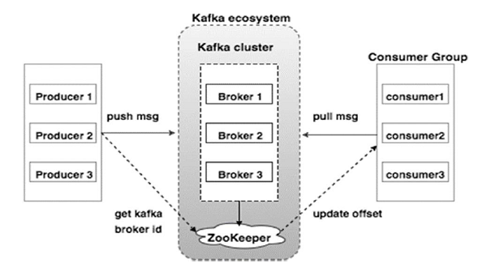
Kafka Architecture
For kafka zookeeper is needed

Slide 5
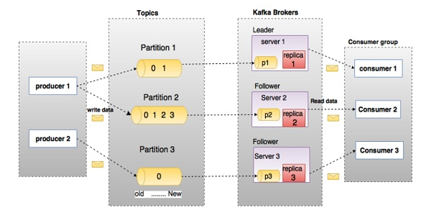
In the above diagram, a topic is configured into three partitions. Partition 1 has two offset factors 0 and 1. Partition 2 has four offset factors 0, 1, 2, and 3. Partition 3 has one offset factor 0. The id of the replica is same as the id of the server that hosts it.Assume, if the replication factor of the topic is set to 3, then Kafka will create 3 identical replicas of each partition and place them in the cluster to make available for all its operations. To balance a load in cluster, each broker stores one or more of those partitions. Multiple producers and consumers can publish and retrieve messages at the same time.

Slide 6
Kafka components
Partition
Topics may have many partitions, so it can handle an arbitrary amount of data.
Replicas are nothing but backups of a partition.
Replicas are never read or write data.
They are used to prevent data loss.
Brokers are simple system responsible for maintaining the pub-lished data. Each broker may have zero or more partitions per topic. Kafka cluster typically consists of multiple brokers to maintain load balance
Kafka Cluster
Kafka’s having more than one broker are called as Kafka cluster
In very simple language :broker does the work of holding the data taken from producers so that the consumer present anywhere in that cluster can have the access/or pull to that message from the broker when needed

Slide 7
Producers
Producers are the publisher of messages to one or more Kafka topics.
Producers send data to Kafka brokers.
Every time a producer pub-lishes a message to a broker, the broker simply appends the message to the last segment file.
Actually, the message will be appended to a partition.
Producer can also send messages to a partition of their choice
Assume, if there are N partitions in a topic and N number of brokers, each broker will have one partition else accordingly accomodated
Consumers
Consumers read data from brokers. Consumers subscribes to one or more topics and consume published messages by pulling data from the brokers.

Slide 8
Producers
Producers push data to brokers. When the new broker is started, all the producers search it and automatically sends a message to that new broker. Kafka producer doesn’t wait for acknowledgements from the broker and sends messages as fast as the broker can handle.
Consumers
Since Kafka brokers are stateless, which means that the consumer has to maintain how many messages have been consumed by using partition offset. If the consumer acknowledges a particular message offset, it implies that the consumer has consumed all prior messages. The consumer issues an asynchronous pull request to the broker to have a buffer of bytes ready to consume. The consumers can rewind or skip to any point in a partition simply by supplying an offset value. Consumer offset value is notified by ZooKeeper

Slide 9
Kafka is simply a collection of topics split into one or more partitions. A Kafka partition is a linearly ordered sequence of messages, where each message is identified by their index (called as offset). All the data in a Kafka cluster is the disjointed union of partitions. Incoming messages are written at the end of a partition and messages are sequentially read by consumers
Following is the step wise workflow of the Pub-Sub Messaging −
Producers send message to a topic at regular intervals.
Kafka broker stores all messages in the partitions configured for that particular topic. It ensures the messages are equally shared between partitions. If the producer sends two messages and there are two partitions, Kafka will store one message in the first partition and the second message in the second partition.
Consumer subscribes to a specific topic.
Once the consumer subscribes to a topic, Kafka will provide the current offset of the topic to the consumer and also saves the offset in the Zookeeper ensemble.
Consumer will request the Kafka in a regular interval (like 100 Ms) for new messages.

Slide 10
Once Kafka receives the messages from producers, it forwards these messages to the consumers.
Consumer will receive the message and process it.
Once the messages are processed, consumer will send an acknowledgement to the Kafka broker.
Once Kafka receives an acknowledgement, it changes the offset to the new value and updates it in the Zookeeper. Since offsets are maintained in the Zookeeper, the consumer can read next message correctly even during server outrages.
This above flow will repeat until the consumer stops the request.
Consumer has the option to rewind/skip to the desired offset of a topic at any time and read all the subsequent messages.

Slide 11
Role of ZooKeeper
A critical dependency of Apache Kafka is Apache Zookeeper, which is a distributed configuration and synchronization service. Zookeeper serves as the coordination interface between the Kafka brokers and consumers. The Kafka servers share information via a Zookeeper cluster. Kafka stores basic metadata in Zookeeper such as information about topics, brokers, consumer offsets (queue readers) and so on.
Since all the critical information is stored in the Zookeeper and it normally replicates this data across its ensemble, failure of Kafka broker / Zookeeper does not affect the state of the Kafka cluster. Kafka will restore the state, once the Zookeeper restarts.

Slide 12
Zookeeper overview

Slide 13
Zookeeper provides a flexible coordination infrastructure for distributed environment. ZooKeeper framework supports many of the today's best industrial applications.
Assume that a Hadoop cluster bridges 100 or more commodity servers. Therefore, there’s a need for coordination and naming services. As computation of large number of nodes are involved, each node needs to synchronize with each other, know where to access services, and know how they should be configured. At this point of time, Hadoop clusters require cross-node services. ZooKeeper provides the facilities for cross-node synchronization and ensures the tasks across Hadoop projects are serialized and synchronized.It is used to keep the distributed system functioning together as a single unitZooKeeper is a distributed co-ordination service to manage large set of hosts. Co-ordinating and managing a service in a distributed environment is a complicated process. ZooKeeper solves this issue with its simple architecture and API. ZooKeeper allows developers to focus on core application logic without worrying about the distributed nature of the application.The ZooKeeper framework was originally built at “Yahoo!” for accessing their applications in an easy and robust manner. Later, Apache ZooKeeper became a standard for organized service used by Hadoop, HBase, and other distributed frameworks. For example, Apache HBase uses ZooKeeper to track the status of distributed data.

Slide 14
leader node
Let us analyze how a leader node can be elected in a ZooKeeper ensemble. Consider there are N number of nodes in a cluster. The process of leader election is as follows −
All the nodes create a sequential, ephemeral znode with the same path, /app/leader_election/guid_.
ZooKeeper ensemble will append the 10-digit sequence number to the path and the znode created will be/app/leader_election/guid_0000000001, /app/leader_election/guid_0000000002, etc.
For a given instance, the node which creates the smallest number in the znode becomes the leader and all the other nodes are followers.
Each follower node watches the znode having the next smallest number. For example, the node which creates znode/app/leader_election/guid_0000000008 will watch the znode/app/leader_election/guid_0000000007 and the node which creates the znode /app/leader_election/guid_0000000007 will watch the znode /app/leader_election/guid_0000000006.

Slide 15
If the leader goes down, then its corresponding znode/app/leader_electionN gets deleted.
The next in line follower node will get the notification through watcher about the leader removal.
The next in line follower node will check if there are other znodes with the smallest number. If none, then it will assume the role of the leader. Otherwise, it finds the node which created the znode with the smallest number as leader.
Similarly, all other follower nodes elect the node which created the znode with the smallest number as leader.

Slide 16
Distributed applications are difficult to coordinate and work with as they are much more error prone due to huge number of machines attached to network. As many machines are involved, race condition and deadlocks are common problems when implementing distributed applications. Race condition occurs when a machine tries to perform two or more operations at a time and this can be taken care by serialization property of ZooKeeper. Deadlocks are when two or more machines try to access same shared resource at the same time. More precisely they try to access each other’s resources which leads to lock of system as none of the system is releasing the resource but waiting for other system to release it. Synchronization in Zookeeper helps to solve the deadlock. Another major issue with distributed application can be partial failure of process, which can lead to inconsistency of data. Zookeeper handles this through atomicity, which means either whole of the process will finish or nothing will persist after failure. Thus Zookeeper is an important part of Hadoop that take care of these small but important issues so that developer can focus more on functionality of the application.

Slide 17
THANK YOU!!

